Slide 1
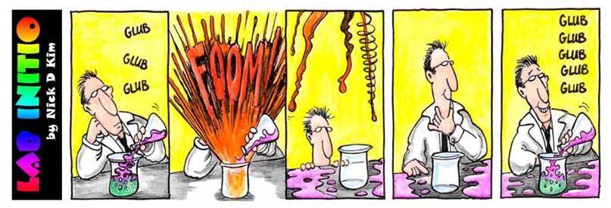
CP Chemistry The study of the composition and properties of matter.
Leslie Kalmer
Notes:
Mr. Mahlman Chemistry Fall 2009
1

Slide 2
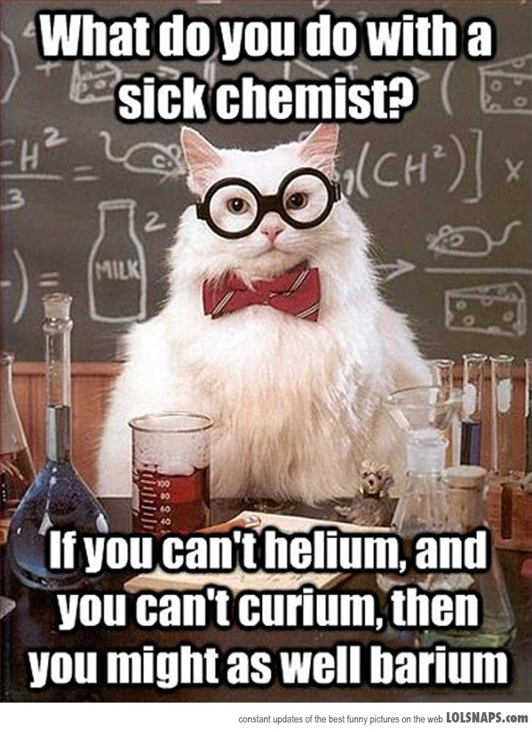
Introduction
About Me ….
Tonight’s Objective:
What will my child learn
How will my child be assessed
How will my child be supported
Email: lkalmer@rjuhsd.us
Webpage: http://rjuhsd.us/lkalmer
Homelink: http://rosevillehsd.net
Phone: (916) 782-3753
Notes:
Mr. Mahlman Chemistry Fall 2009
2
18th year teaching

Slide 3
What will my child learn: Course Overview
(NGSS) Next Generation Science Standards - Chemistry
1st Midterm
Properties of Matter
Atomic structure
Modern Atomic Theory
Nomenclature
Bonding
2nd Midterm
The Mole
Chemical Reactions
Stoichiometry
Solutions
Acids and Bases
Thermochemistry
Notes:
Mr. Mahlman Chemistry Fall 2009
3

Slide 4
Common Core In Science
Incorporating inquiry and critical thinking into class using Claim, Evidence and Reasoning
Connections to the Common Core Standards for Literacy in Science
Connections to the Common Core Standards for English and Math
Linking curriculum to Science and Engineering practices
Notes:
Mr. Mahlman Chemistry Fall 2009
4

Slide 5
Course Rationale
Fulfill Requirements:
- Physical Science for graduation from RHS
- 2nd year of Lab Science for CSU and UC (A-G)
Prepare for AP Chemistry
Learn about real world Chemistry
Learn problem solving techniques and be challenged by concepts

Slide 6
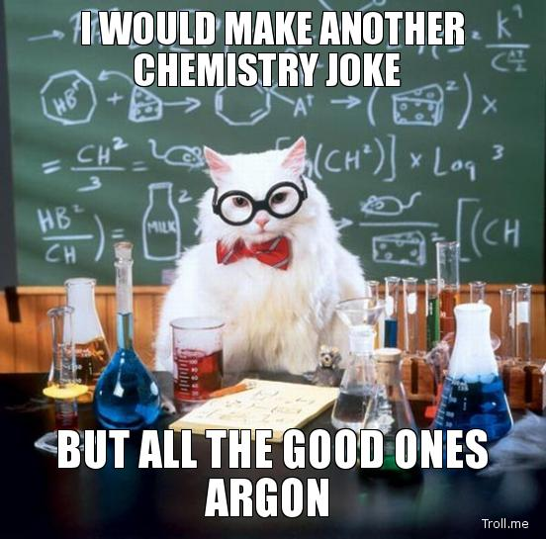
How will my child be assessed? Grades are a weighted average:
15% Homework: Will accept late
work with a parent note!
15% Labs / Activities
5% Quizzes - Practice, Practice!!
45% Tests: Common RHS tests as well as district assessments; Free Response and Multiple Choice questions: RETAKES! (85%)
20% Midterm/Final

Slide 7
Grading Policy
100% - 93% A 90% - 92.99% A -
89% - 83% B 80% - 82.99% B -
79% - 73% C 70% - 72.99% C -
69% - 63% D 60% - 62.99% D -
64% - 0% F
Progress reports/grades sent home every 4.5 weeks.
Check Homelink for current grades and homework

Slide 8
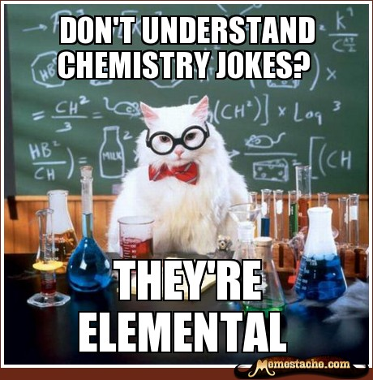
How will my child be Supported?
Encourage your child to ASK FOR HELP!
Students CAN get help:
- All Lessons / HW answers on Google Drive/Classroom
- My classroom (before/after school by appointment)
Free Tiger Tutoring T, W, Th after school from 2:45 – 4. Student and teacher tutors. Attendance is recorded. Chromebooks will be available.
Textbooks - sample problems in each chapter
Online tutorials (Khan academy, etc)
Practice Test Questions on my website

Slide 9
ROAR
ROAR is designed to help those students that are struggling and need more support
D and F students must attend
Absent students or those that need to complete work must attend
Those that have specific questions should attend.

Slide 10
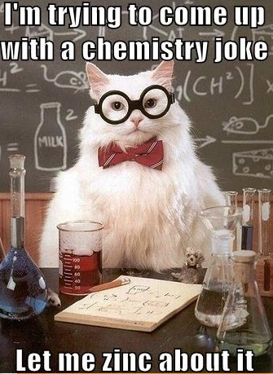
Contact Information
email: lkalmer@rjuhsd.us
webpage: http://rjuhsd.us/lkalmer
Homelink: http://rosevillehsd.net
Phone: (916) 782-3753

Slide 11
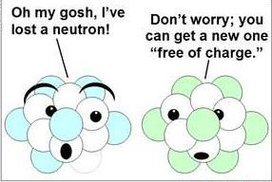
Questions? Thank you for coming to Back to School Night!!

